Slide 1
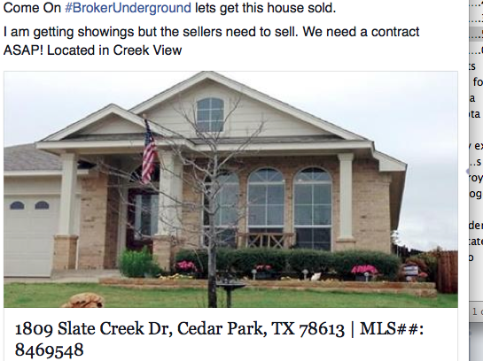
Secret clubs that aren’t secret!

Slide 2

Your thoughts……

Slide 3
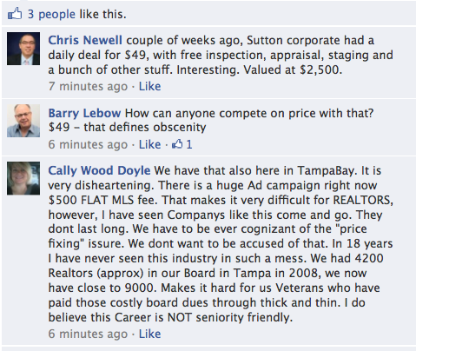
Brokerage Models/Anti-Trust

Slide 4
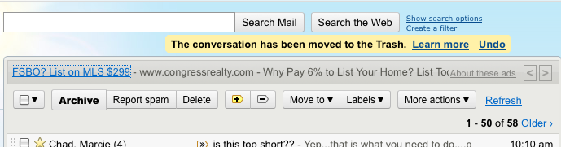
Anti-trust violations: Call the FTC

Slide 5


Slide 6

Q & A Platforms
Trulia Voices
Zillow Advice
Yahoo! Answers

Slide 7
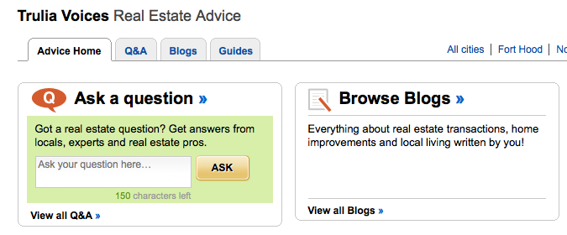
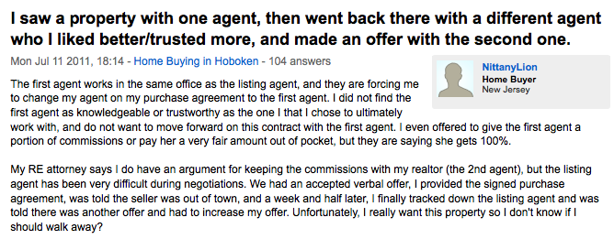
Danger Lurks Here!

Slide 8
…AND ANSWER QUESTIONS ON TRULIA VOICES
“As for the MLS or discount brokers, sometime it does appear on the MLS but 1) that broker only wants to list your house to get buyer leads so he can sell them other homes that aren’t overpriced. 2) Me being a realtor, I know which brokers are discount brokers and I never show there homes. If I bring an offer and then the owner gets a little lower offer he will take that one because he is FSBO and doesn’t have to pay commission so I wasted my time showing that home and not get paid. 3) If I show it and the buyers go directly to the owner then im out of commission so I steer them away from those properties. Do it right the first time and hire a qualified realtor rather then waste your money GOOD LUCK!!!!”

Slide 9

NAR Trademark Violations

Slide 10
And they’re Blogging
Your opinion or the company’s?

Slide 11
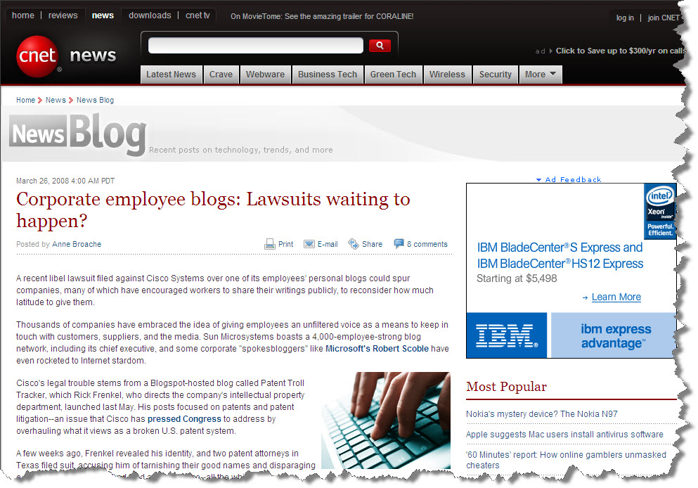
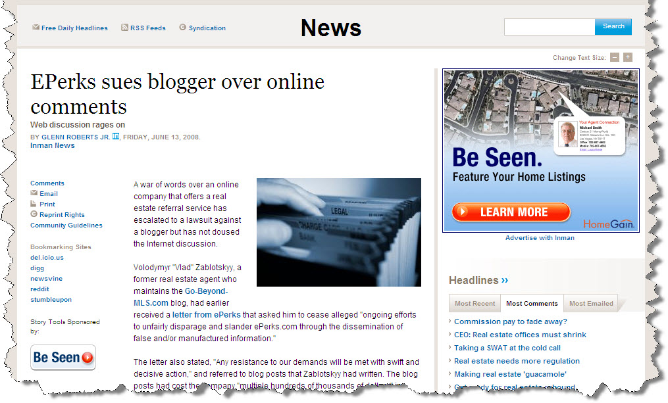
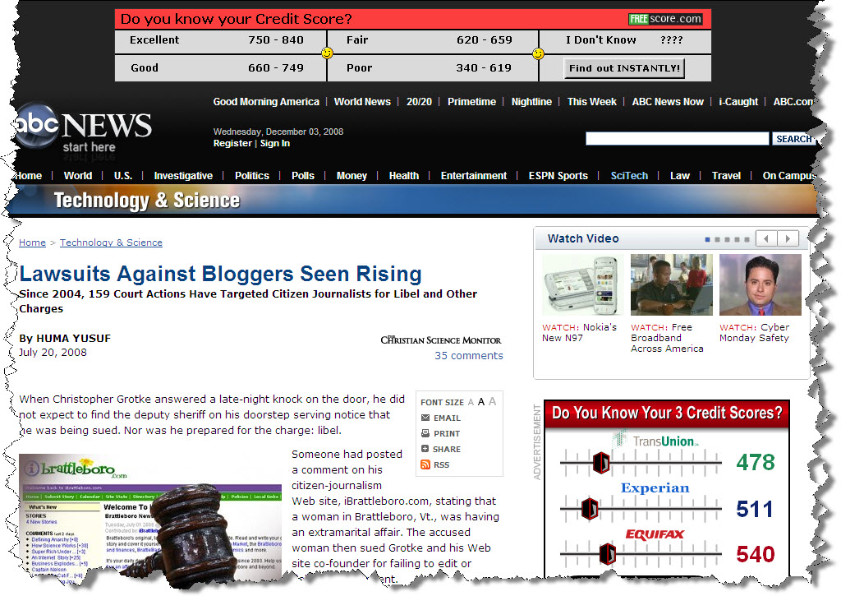
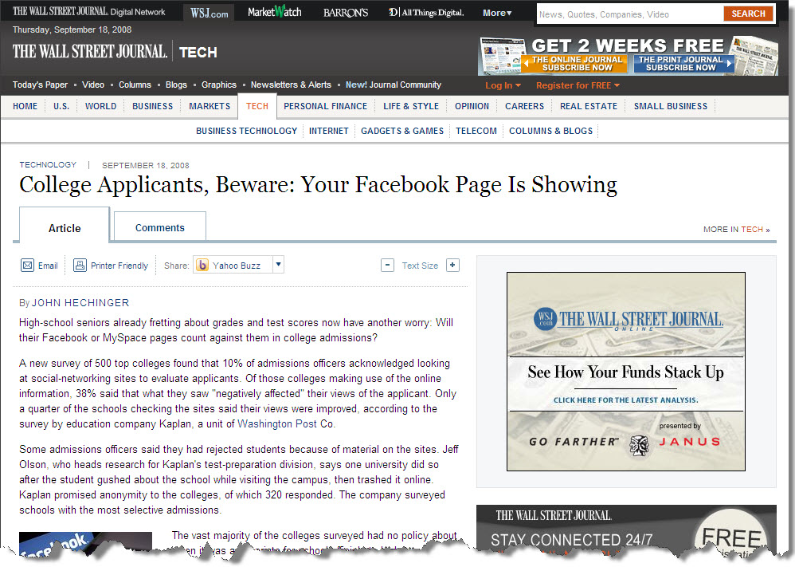
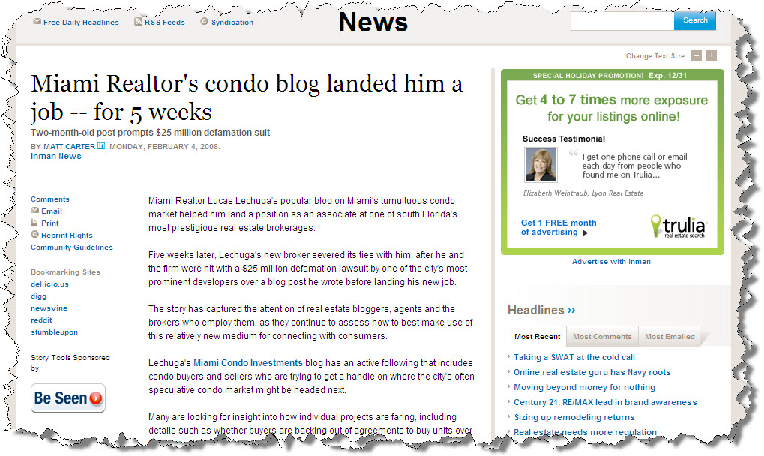
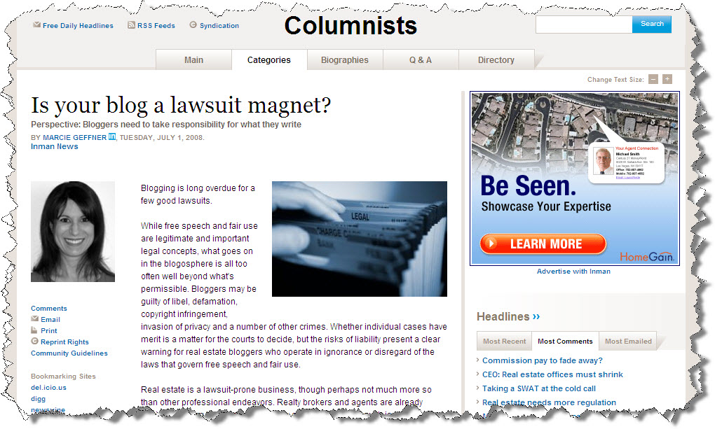
Freedom of Speech???
Notes:
Blogging became a fast hit with realtors. It was a way to promote a city, a neighborhood, yourself…how and when to buy…when to sell…market conditions, etc! Well the probably with blogging is that it is normally ‘your opinion’…so when that opinion turns out to be wrong, then what you have is the potential for a lawsuit and shown by thiese articles.

Slide 12
THE OPINIONS EXPRESSED ON THIS BLOG ARE MY OWN PERSONAL OPINIONS. THEY DO NOT REFLECT THE OPINIONS OF MY COMPANY!
Absolute must caption on blog sites!

Slide 13
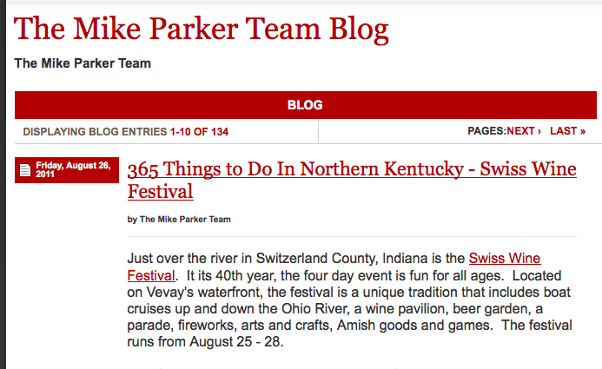
Real Estate or Info?

Slide 14

Listing Syndication
Notes:
Outline property listing syndication methods and systems for updating listings and keeping them current on all platforms.

Slide 15
Listing Data Feeds
Vendor
Marketing & Syndication (Listhub, Point2 Agent, Postlets)
MLS
Web Site (Point2 Agent and z57)
Homes Magazines
Franchise
Broker
Agent

Slide 16


= Broker feed
= Agent feed

Slide 17
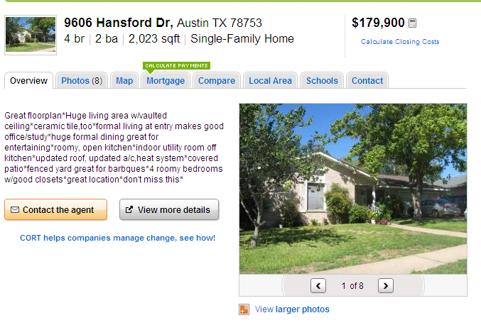
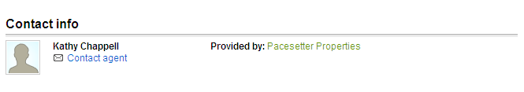
Brokerage Name

Slide 18
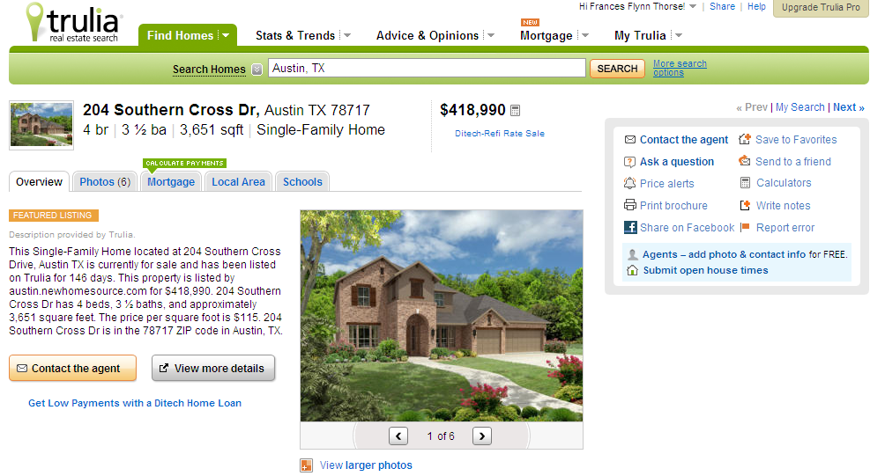
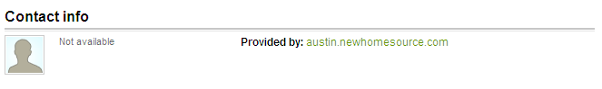
No Brokerage Name, No Contact Info

Slide 19
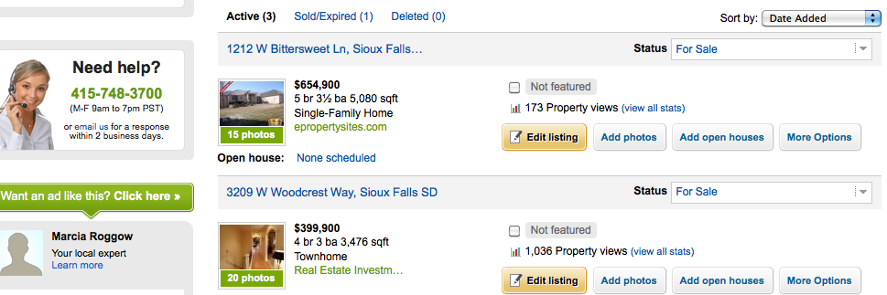
Here’s how you know!

Slide 20
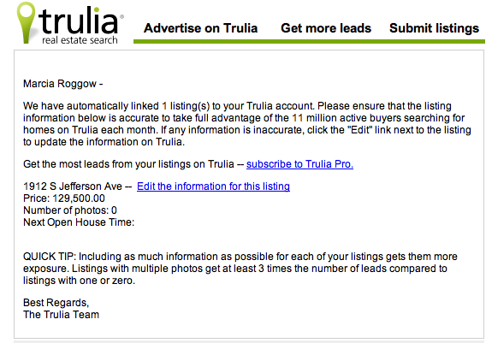
Check the information for correctness

Slide 21
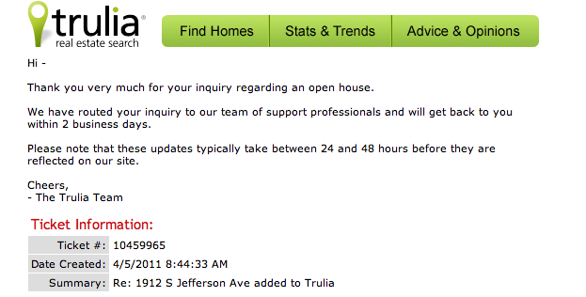
Correct Errors….

Slide 22
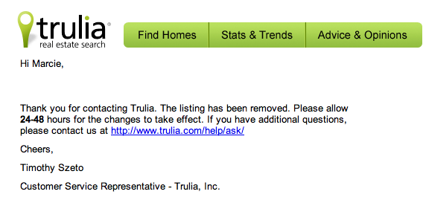
Keep at it!!!!

Slide 23
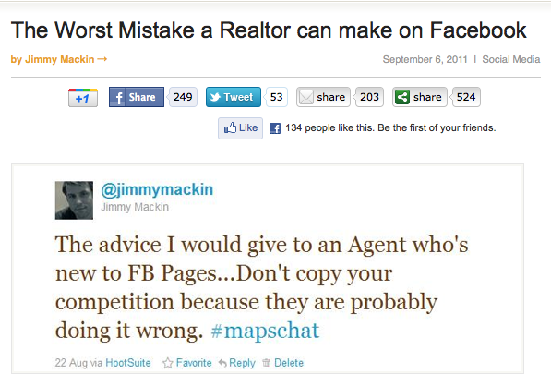
A little advice from Inman

Slide 24
NAR MLS Rules and Regulations
“MLS Compilation” means any format in which property listing data is collected and disseminated to the Subscribers, including, but not limited to, bound book, loose-leaf binder, computer database, card file, or any other format determined by the Board.
“Modified Public MLS” means that portion of the Private MLS that the MLS elects to make available to Subscribers for use on the Subscriber’s web-site, as further defined in Section 13 of the MLS Rules and Regulations.

Slide 25
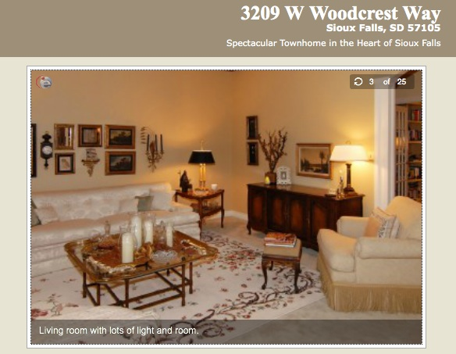
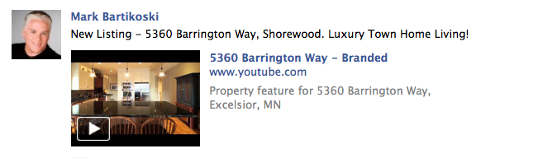
MLS Rules and Regulations Branded vs. Unbranded Tours

Slide 26

Copyright Issues…….

Slide 27
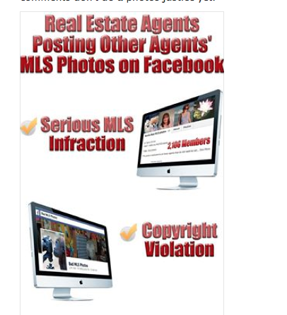
It’s a MESS out there!

Slide 28
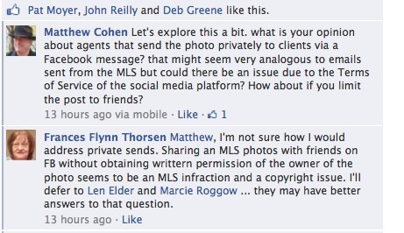
The pictures in the MLS are copyrighted to the MLS!

Slide 29

It’s a Puzzle- Do you understand the pieces?
License Law
MLS Rules
Ethics Codes

Slide 30


Slide 31

Professional Standards Committees
Are going to be busy!
How will you monitor these changes and the violations that could occur?
Notes:
And speaking of them…I sense that they will be busy this year! But in an environment that is only growing…how in the world do you keep track of all of the tweets and the instant messages and facebook entries. There in lies the big question. Brad and I are hear to help answer some of them through a presentation that he is doing on Friday of next week as part of our CRB meetings…..brad tells us about it, briefly…

Slide 32

Thanks for joining me today!
Marcie Roggow, ABR, CCIM, CRB, CRS, DREI, GRI, SRS
Marcie@marcieroggow.com
…ushering a new age of broker e-empowerment

